Slide 1
Integrated Locality Teams across Leicester, Leicestershire and Rutland

Slide 2
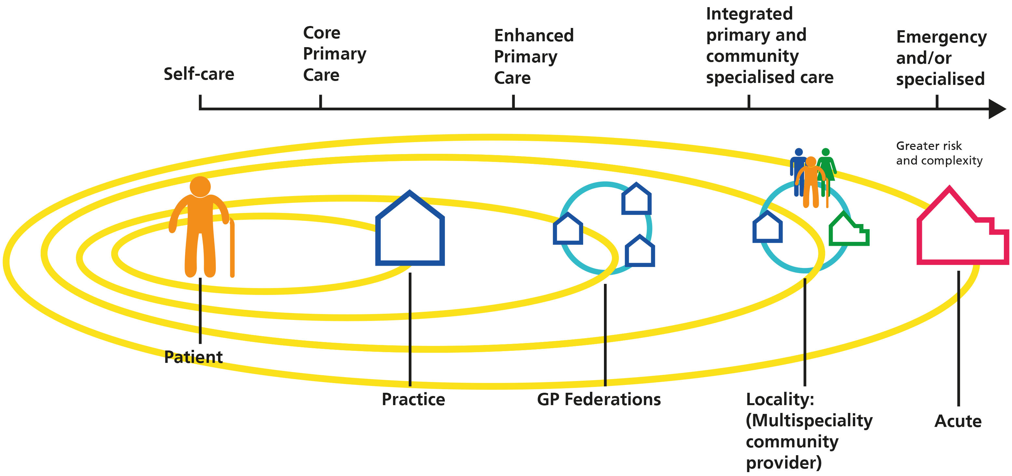
Our Model Ambition
Our model of integration wraps around the patient and their GP practice, extending the care and support that can be delivered in community settings through multidisciplinary working
PHILOSOPHY = HOME FIRST
Proactive, integrated care.
Care coordinated
across settings, organisations,
and professions
Use diagnostic hubs and ambulatory pathways for episodes of acute illness
Clinical specialists coordinate via integrated MDT – keep at home
Emergency admission if unstable) but a plan to discharge ASAP
GP practice continue to coordinate and lead care
Mr Jones
DM
10+
HOME=BED
DIAGNOSE TO ADMIT
DISCHARGE TO ASSESS

Slide 3
What do we want to achieve? HOME FIRST!
The overarching model of care across LLR is the “home first “model.
In practical terms this means everyone should ask:
“Why is this patient not at home?” or
“How best can we keep them at home?”
INTEGRATED LOCALITY TEAMS
ARE KEY TO DELIVERY OF HOME FIRST IN LLR

Slide 4
Who will benefit from the model?
PHASE 1 = 3 cohorts:
Adults with 5 or more chronic conditions
Adults with a ‘frailty’ marker, regardless of age but related to impaired function
Adults whose secondary care costs are predicted to cost three or more times the average cost over the next twelve months (Including people transitioning to end of life care, intensive specialist community or residential care)
In the future the whole population will benefit from integrated locality teams.

Slide 5
Outcomes
Outcome | Metric | What is the Locality Integrated Team ask ?
Improve health outcomes and wellbeing | Health function status Risk Status Mortality/Morbidity Maintaining Independence Numbers entering reablement Broader wellbeing metrics | Develop a deep understanding of the needs of the three groups of service users, across organisational boundaries and data sets. Identify how care and support varies, why it varies, and how these differences can be addressed. Define new ways of working and support staff to change their practice. Undertake some initial tests of new ways of working. Plan how the new ways of working can be rolled out across all eleven localities during 2017/18.
Improve the individual patient /service user ,clinician and staff experience and satisfaction | Patient experience – safe , effective, timely, efficient, patient centred (including national voices) Staff satisfaction Recruitment and retention rates
Moderate the cost of delivering care | Total cost per member of the population per month. Hospital and ED utilisation rate, for example admission; readmissions; bed days.

Slide 6
The Model

Slide 7
The Way we will work....../
Patients, carers and family are at the centre of this model
Create a standardised consistent offer for our citizens and patients through Leicester, Leicestershire and Rutland wide service redesign with interventions delivered at a local level.
Focus on prevention, the individuals responsibility for their own health and wellbeing, early diagnosis and management of risk factors.
Target our resources more effectively based on detailed understanding of population need, demand, service journeys/utilisation and real time data.
Through co-redesign, create far more cost efficient and clinically effective person-centred models of care.
Through an allocated placed based budget and integration of health and social care teams, care will be delivered in the right place, first time.
The integrated team will operate “as one”, delivering joint outcomes for the population they serve.
Joint accountability for care coordination and outcomes, across organisational boundaries and teams
A trusted assessment concept is central to the application of this model

Slide 8
What we will do…
Double click table to enter information.
Key: Red = Not at all Amber = Partially Green = Fully

Slide 9
What we will do…

Slide 10
What we will do…

Slide 11
What we will do…

